Slide 1
Chapter 3: The Adjusting Process
Financial & Managerial Accounting, 16e

Slide 2
Accrual and Cash Bases of Accounting
Under the accrual basis of accounting, revenues are reported on the income statement in the period in which a service has been performed or a product has been delivered.
Under the cash basis of accounting, revenues and expenses are reported on the income statement in the period in which cash is received or paid.

Slide 3
Revenue and Expense Recognition (1 of 2)
Under the revenue recognition principle, revenues are recorded when earned, which is when the services have been performed or products have been delivered to customers.
Revenue is normally measured as the assets are received, such as cash or accounts receivable.

Slide 4
Revenue and Expense Recognition (2 of 2)
Under the expense recognition principle, the expenses incurred in generating revenue must be reported in the same period as the related revenue.

Slide 5
Types of Accounts Requiring Adjustment
The two general classifications of accounts requiring adjustment are as follows:
Accruals
Deferrals

Slide 6
Types of Accounts Requiring Adjustment (1 of 2)
An accrual occurs when revenue has been earned or an expense has been incurred but has not been recorded.
If the accrual is for revenue, the adjusting entry debits an asset (Accounts Receivable) and credits a revenue account.
If the accrual is for an expense, the adjusting entry debits an expense account and credits a related liability account such as Accounts Payable or Wages Payable.

Slide 7
Types of Accounts Requiring Adjustment (2 of 2)
A deferral occurs when cash related to a future revenue or expense has been initially recorded as a liability or an asset.
If the cash received is related to future revenue, it is initially recorded as a liability called unearned revenue.
The adjusting entry in the period when the revenue is earned debits an unearned revenue account and credits a revenue account.
If the cash paid is related to a future expense, it is initially recorded as an asset called prepaid expense.
The adjusting entry in the period when the expense is incurred debits an expense account and credits a prepaid expense (asset) account.

Slide 8
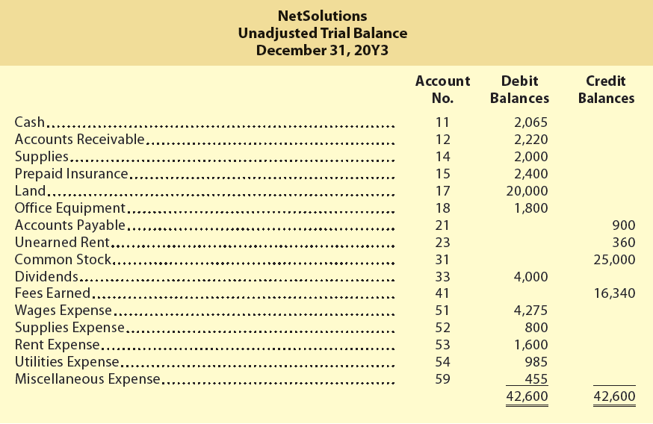
Adjusting Entries for Accruals (Learning Objective 2) Exhibit 3 – Unadjusted Trial Balance for NetSolutions

Slide 9
Exhibit 4 – Expanded Chart of Accounts for NetSolutions
Balance Sheet Accounts
1. Assets 11 Cash 12 Accounts Receivable 14 Supplies 15 Prepaid Insurance 17 Land 18 Office Equipment 19 Accumulated Depreciation—Office Equipment 2. Liabilities 21 Accounts Payable 22 Wages Payable 23 Unearned Rent 3. Stockholders’ Equity 31 Common Stock 32 Retained Earnings 33 Dividends
Income Statement Accounts
4. Revenue
41 Fees Earned
42 Rent Revenue
5. Expenses
51 Wages Expense
52 Supplies Expense
53 Rent Expense
54 Utilities Expense
55 Insurance Expense
56 Depreciation Expense
59 Miscellaneous Expense

Slide 10
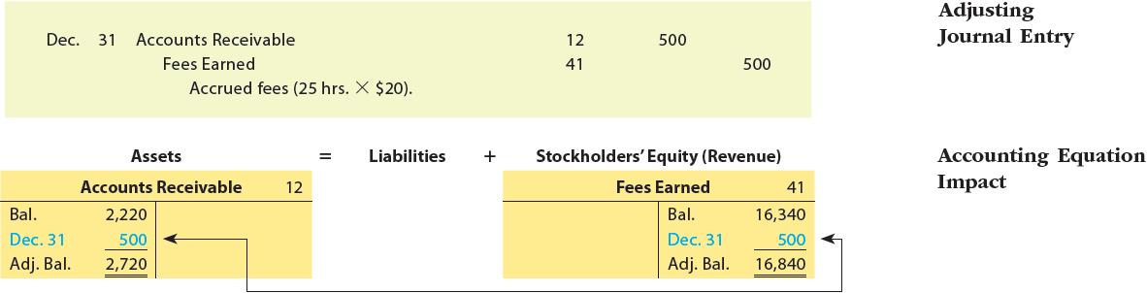
Accrued Revenues (2 of 3)
Assume that NetSolutions signed an agreement with Dankner Co. on December 15 to provide services at a rate of $20 per hour.
As of December 31, NetSolutions had provided 25 hours of services. The revenue will be billed on January 15.

Slide 11
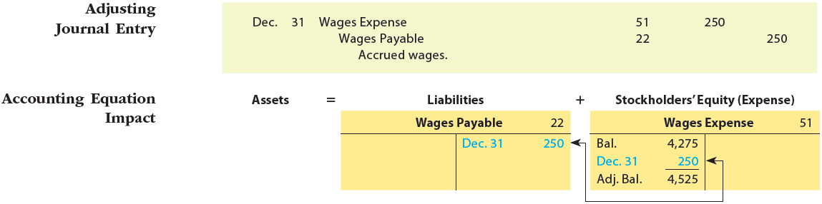
Accrued Expenses (3 of 5)
The adjusting journal entry and T accounts are as follows:

Slide 12
Knowledge Check Activity 1
At the end of an accounting period, an adjusting entry to record revenue that has been earned but not yet recorded would include which of the following?
debit an asset account; debit a revenue account
debit an asset account; credit a revenue account
credit an asset account; debit a revenue account
credit an asset account; credit a revenue account

Slide 13
Knowledge Check Activity 1: Answer
At the end of an accounting period, an adjusting entry to record revenue that has been earned but not yet recorded would include which of the following?
Answer: b. debit an asset account; credit a revenue account
At the end of an accounting period, when there may be revenue that has been earned but has not been recorded, the revenue is recorded by increasing (debiting) an asset account and increasing (crediting) a revenue account.

Slide 14
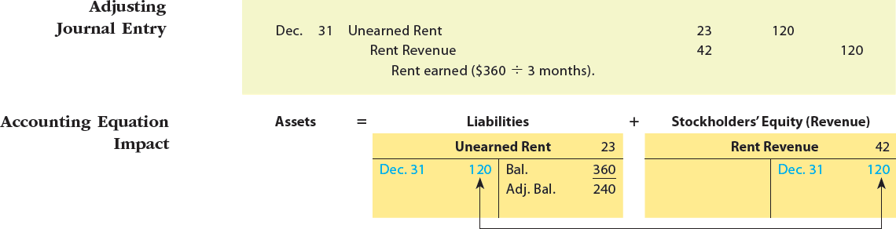
Adjusting Entries for Deferrals (LO3) Unearned Revenues (1 of 2)
The December 31 unadjusted trial balance of NetSolutions indicates a balance in the unearned rent account of $360.
This balance represents the receipt of three months’ rent on December 1 for December, January, and February.
At the end of December, one month’s rent has been earned.
The adjusting journal entry and T accounts are as follows:

Slide 15
Prepaid Expenses
The December 31, 20Y3, unadjusted trial balance of NetSolutions indicates a balance in the supplies account of $2,000.
In addition, the prepaid insurance account has a balance of $2,400.
Each of these accounts requires an adjusting entry.

Slide 16
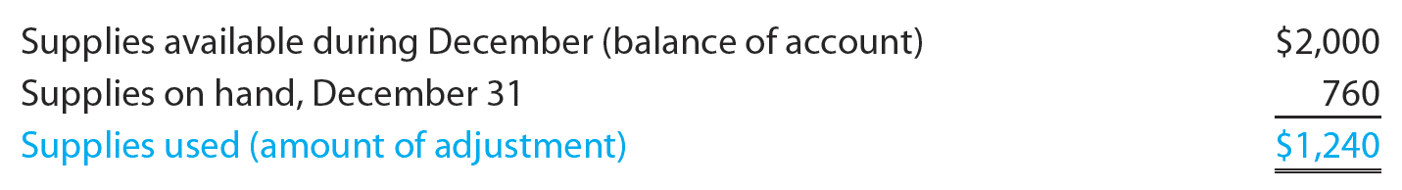
Prepaid Expenses: Supplies
The December 31, 20Y3 unadjusted trial balance of NetSolutions indicates a balance in the supplies account of $2,000. Some of these supplies were used during December, and some are still on hand (not used). Assuming that on December 31 the amount of supplies on hand is $760, the amount to be transferred from the asset account to the expense account is computed as follows:

Slide 17
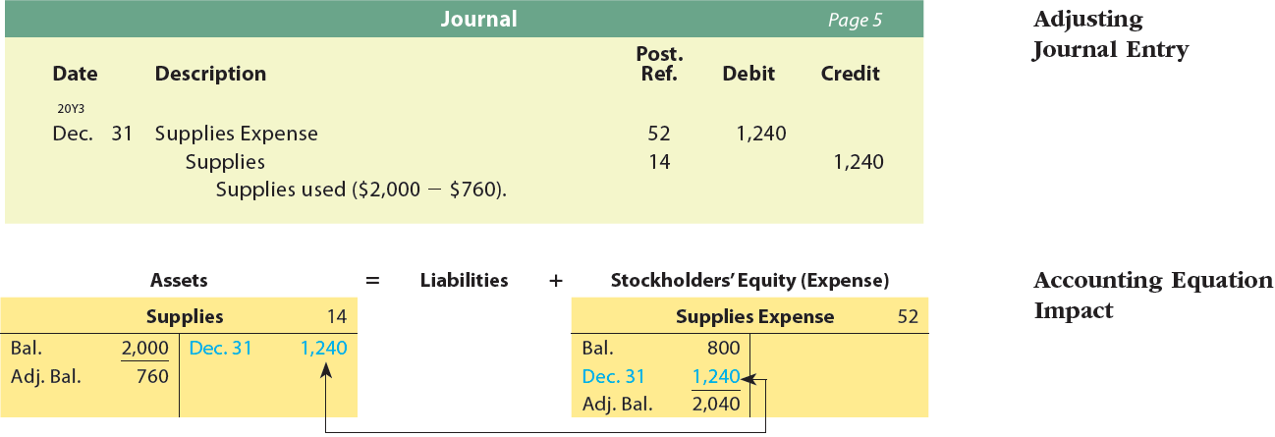
Prepaid Expenses – Supplies
Notes:
The balance in NetSolutions’ supplies account on December 31 is $2,000.
Some of these supplies (paper, envelopes, etc.) were used during December, and some are still on hand (not used).
Assuming that on December 31 the amount of supplies on hand is $760, the amount to be transferred from the asset account to the expense account is $1,240, computed as follows:
Supplies available during December (balance of account) $ 2,000
Supplies on hand, December 31 (760)
Supplies used (amount of adjustment) $ 1,240

Slide 18
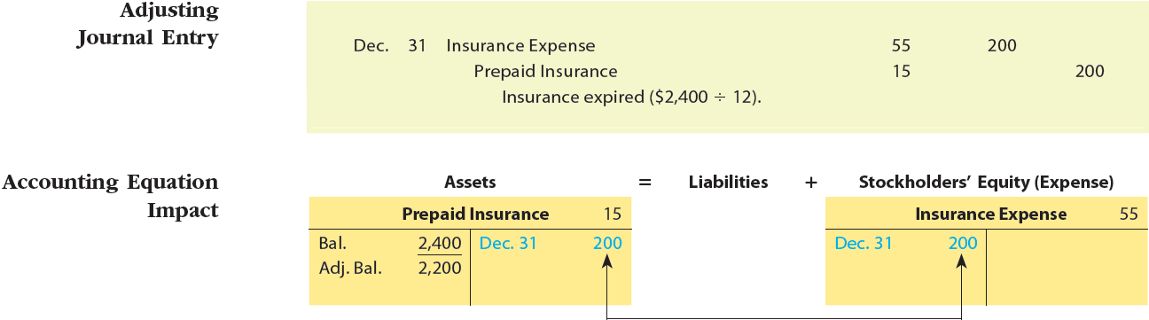
Prepaid Insurance
The debit balance of $2,400 in NetSolutions’ prepaid insurance account represents a December 1 prepayment of insurance for 12 months.
At the end of December, the insurance expense account is increased (debited), and the prepaid insurance account is decreased (credited) by $200, the insurance for one month.
The adjusting journal entry and T accounts for Prepaid Insurance and Insurance Expense are as follows:

Slide 19
Knowledge Check Activity 2
On November 20, Cassie purchases a $200 ticket on Delta Airlines to fly to Orlando on January 28 of the next year. Assuming Delta Airlines has a fiscal year end of December 31, which account would they credit to record the sale of this airline ticket on November 20?
Sales
Cash
Unearned Revenue
Accounts Receivable

Slide 20
Knowledge Check Activity 2: Answer
On November 20, Cassie purchases a $200 ticket on Delta Airlines to fly to Orlando on January 28 of the next year. Assuming Delta Airlines has a fiscal year end of December 31, which account would they credit to record the sale of this airline ticket on November 20?
Answer: c. Unearned Revenue
Even though Delta has collected the cash from the customer for the sale of the ticket on November 20, at the end of the fiscal year on December 31, they have not yet provided the service for this sale (the flight has not yet occurred). They cannot claim the $200 sale until after the flight has taken place on January 28. The Unearned Revenue account, which is a liability, can “hold” the revenue until it is actually earned.

Slide 21
Depreciation Expense
Fixed assets, or plant assets, are physical resources that are owned and used by a business and are permanent or have a long life.
Examples of fixed assets include land, buildings, and equipment.

Slide 22
Depreciation Expense
As time passes, a fixed asset loses its ability to provide useful services.
This decrease in usefulness is called depreciation.
This periodic expense is called depreciation expense.
Accumulated depreciation accounts are called contra accounts, or contra asset accounts.

Slide 23
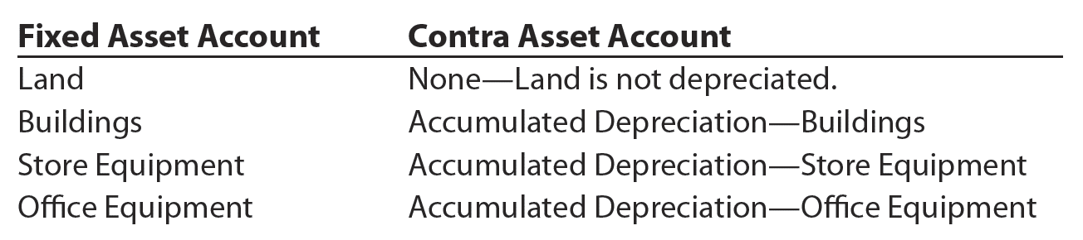
Depreciation Expense
The normal titles for fixed asset accounts and their related contra asset accounts are as follows:

Slide 24
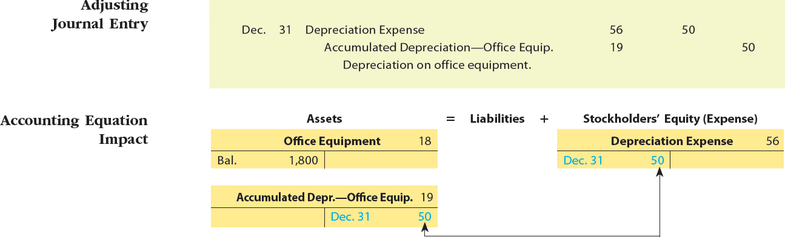
Adjusting Entries for Depreciation (5 of 8)
The December 31, 20Y3, unadjusted trial balance of NetSolutions indicates that NetSolutions owns two fixed assets: land and office equipment.
Land does not depreciate; however, an adjusting entry is recorded for the depreciation of the office equipment for December.
Assume that the office equipment depreciates $50 during December.
The adjusting journal entry and T accounts are as follows:

Slide 25
Knowledge Check Activity 3
Miller Cement Works, Inc. paid $120,000 for a used cement mixer truck. It has an estimated life of 10 years. After six years, the truck has accumulated depreciation of $72,000, and its net book value is:
$48,000
$0
$72,000
$120,000

Slide 26
Knowledge Check Activity 3: Answer
Miller Cement Works, Inc. paid $120,000 for a used cement mixer truck. It has an estimated life of 10 years. After six years, the truck has accumulated depreciation of $72,000, and its net book value is:
Answer: a. $48,000
The net book value of the truck after six years will be its purchase price less accumulated depreciation: $120,000 - $72,000 = $48,000.

Slide 27
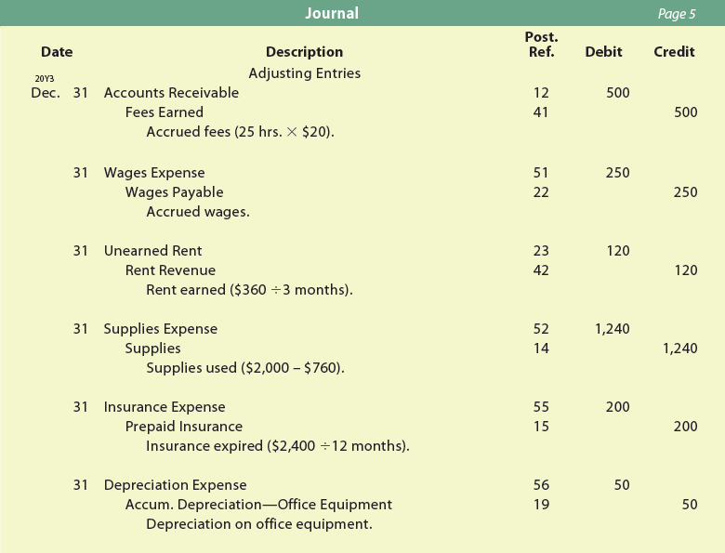
Exhibit 7 – Adjusting Entries—NetSolutions

Slide 28
Adjusted Trial Balance (Learning Objective 6)
After the adjusting entries are posted, an adjusted trial balance is prepared.
The adjusted trial balance verifies the equality of the total debit and credit balances before the financial statements are prepared.
If the adjusted trial balance does not balance, an error has occurred.

Slide 29
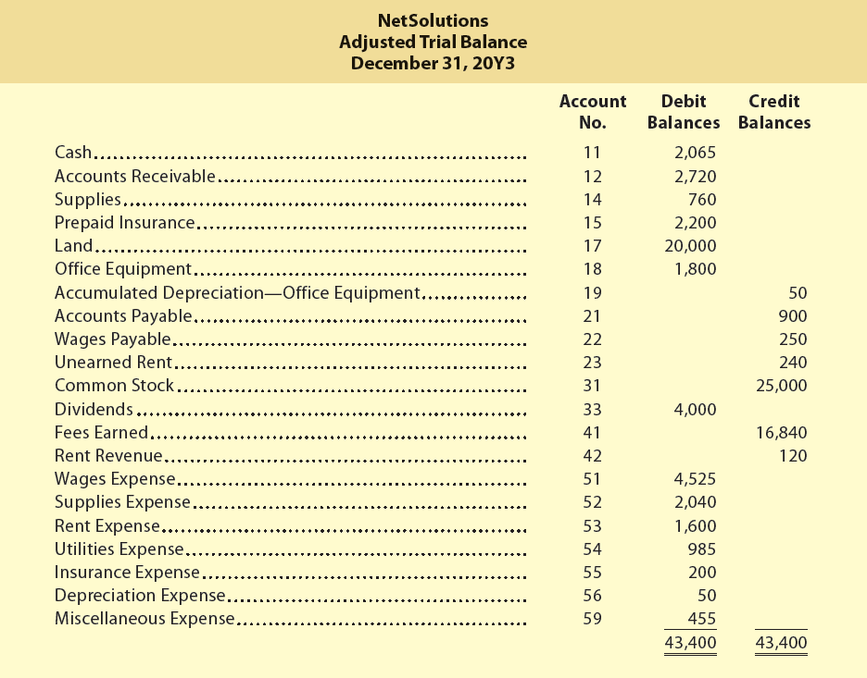
Exhibit 9 – Adjusted Trial Balance

